Slide 1
Digital Portfolio
STUDENT NAME: Janani S.B
REGISTER NO AND NMID: asbruaj2428c0188
DEPARTMENT: BSC
COLLEGE: A.V.P COLLEGE OF ARTS AND SCIENCE / Bharathiar university

Slide 2
PROJECT TITLE
Academic Portfolio Management System

Slide 3


AGENDA
Problem Statement
Project Overview
End Users
Tools and Technologies
Portfolio design and Layout
Features and Functionality
Results and Screenshots
Conclusion
Github Link
3/21/2024 Annual Review

Slide 4

PROBLEM STATEMENT
Traditional student portfolios are maintained on paper or scattered digital files.
Lack of a centralized system makes it hard to track academic growth.
Difficulties in showcasing achievements for placements, higher studies, or scholarships.
Manual effort required for maintaining updates and reviewing performance.

Slide 5
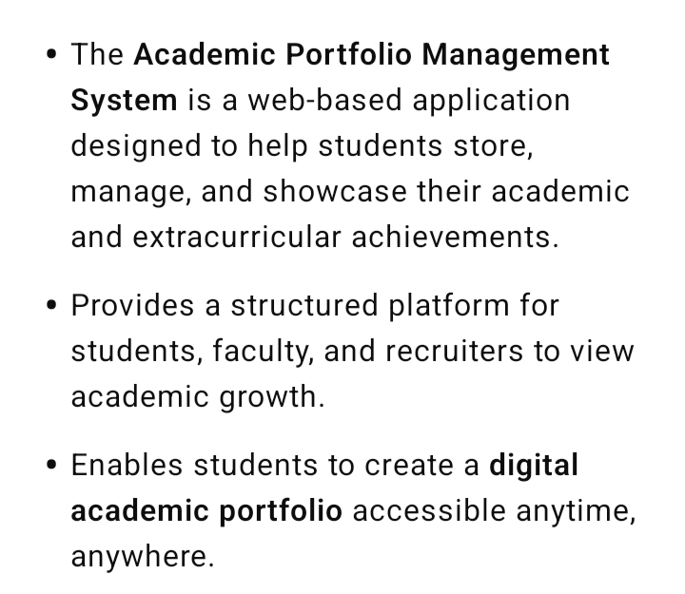

PROJECT OVERVIEW

Slide 6
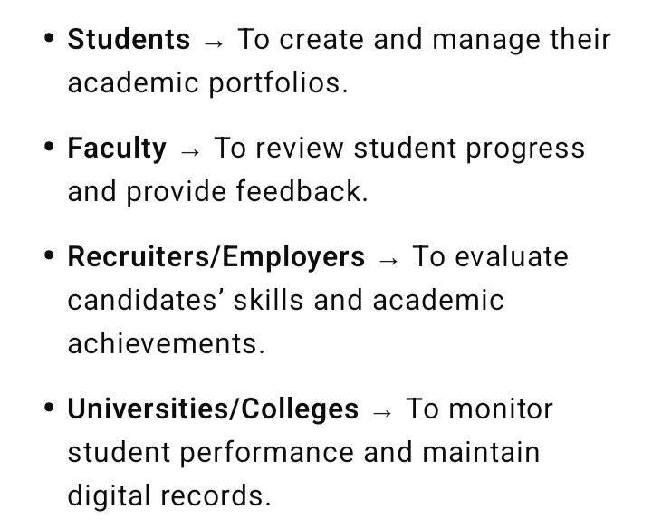

WHO ARE THE END USERS?

Slide 7

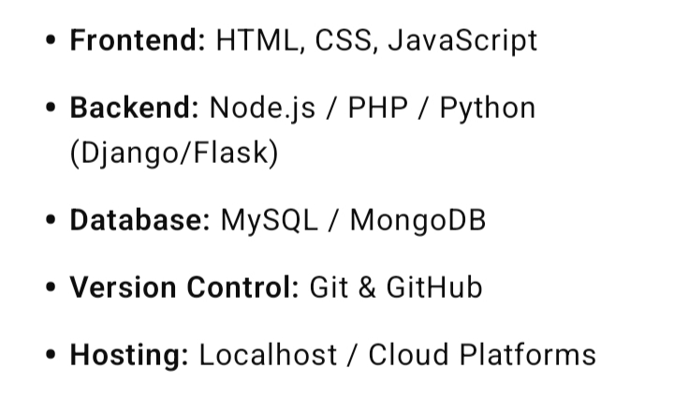
TOOLS AND TECHNIQUES

Slide 8
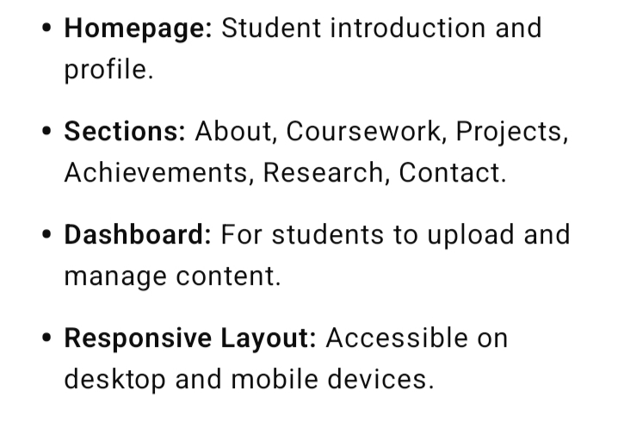
POTFOLIO DESIGN AND LAYOUT
8

Slide 9
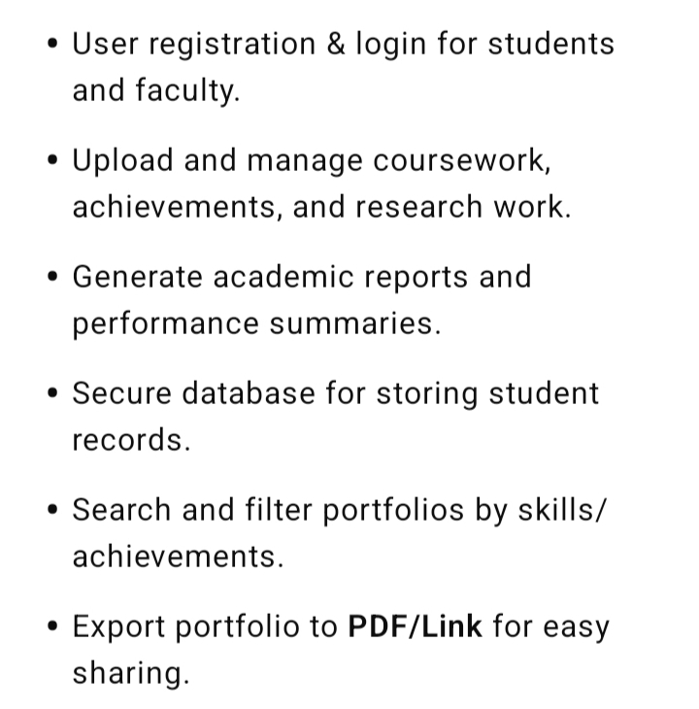
FEATURES AND FUNCTIONALITY

Slide 10
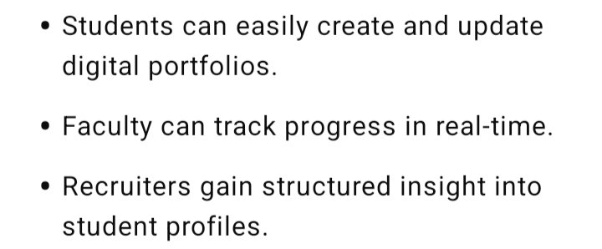
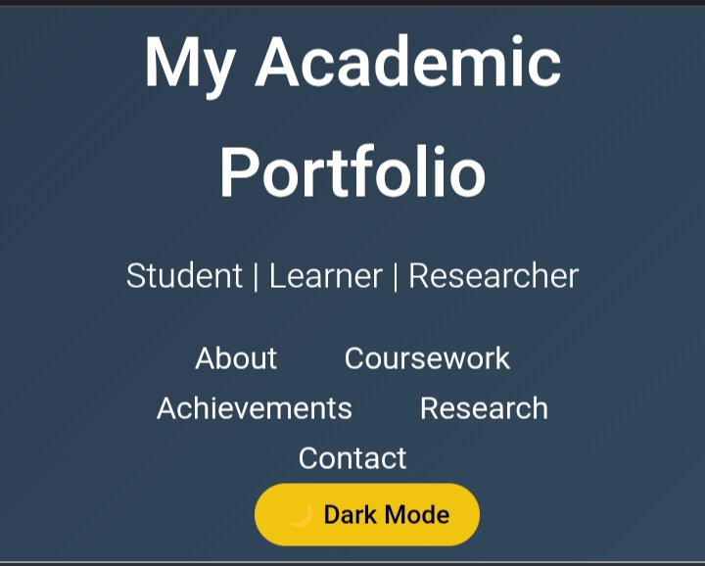
RESULTS AND SCREENSHOTS
3/21/2024 Annual Review
10

Slide 11
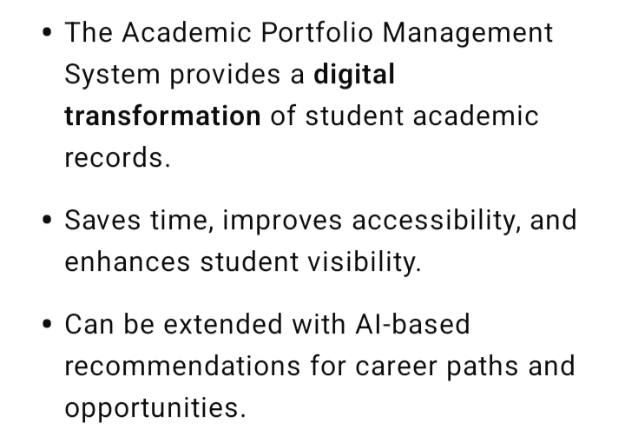
CONCLUSION
11

Slide 12
GitHub LINK

